Slide 1
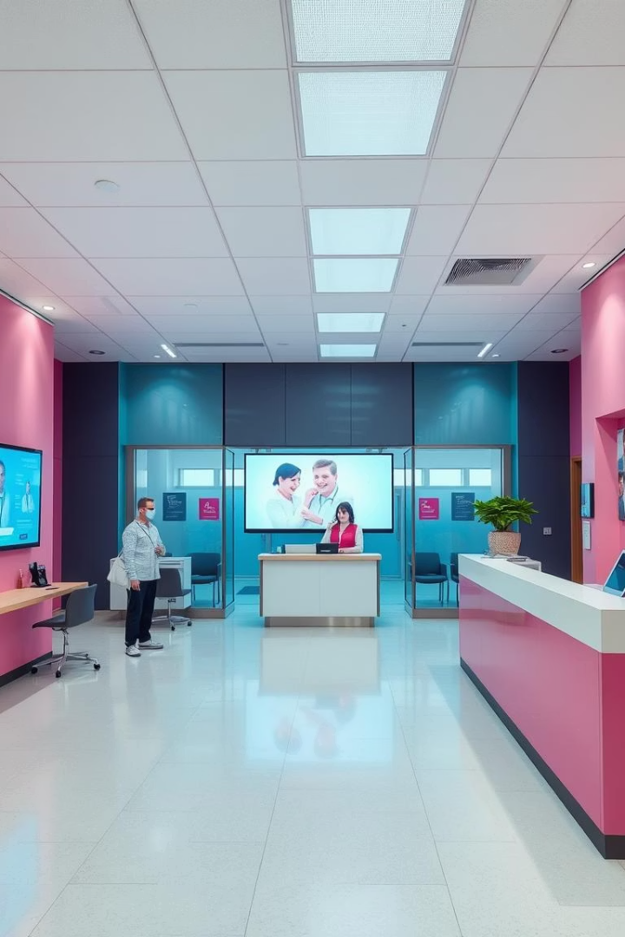
Hospital Management System
(TEAM-2) A-2
2310030021-SATHWIK RAM , 2310030101-LALITHYA B,
2310030203-RAKESH, 2310030404-SANIA BASHA
Revolutionizing patient care and operational efficiency through a complete hospital management system.
Features include Appointment Booking, Online Prescriptions, and Role-Based Access.
Our goal: systematically manage hospital operations for better service.

Slide 2
Key Features: Appointment Booking System
24/7 online scheduling with real-time doctor availability.
Automated reminders cut no-shows by 30%
Seamless connection to electronic health records (EHR)
Integrated calendar sync for efficient appointment management.

Slide 3

Key Features: Online Prescription Checking
Secure Access
Error Reduction
Patients and doctors access prescriptions safely online.
Automated checks lower prescription mistakes by 15%.
Fast Pharmacy Transmission
Data Privacy
Electronic prescriptions speed up medication fulfillment.
Compliance with HIPAA ensures patient data protection.

Slide 4

Role-Based Access: Administrator
System Setup
User management and configuration controls.
Data & Analytics
Access to system-wide reports and performance metrics.
Security
Ensures protection of sensitive hospital information.
Monitoring
Tracks key performance indicators (KPIs) in real time.

Slide 5
Role-Based Access: Staff
Schedule appointments and update patient records
Workflows tailored to job roles for efficiency
Handle billing and administrative tasks
Improved communication and task coordination

Slide 6

Benefits & Outcomes
Better Satisfaction
Patient satisfaction increased by 20%
Cost Savings
Administrative expenses lowered by 15% via automation
Boosted Productivity
Staff efficiency and workflow significantly enhanced
Data-Driven
Improved decisions via robust analytics

Slide 7
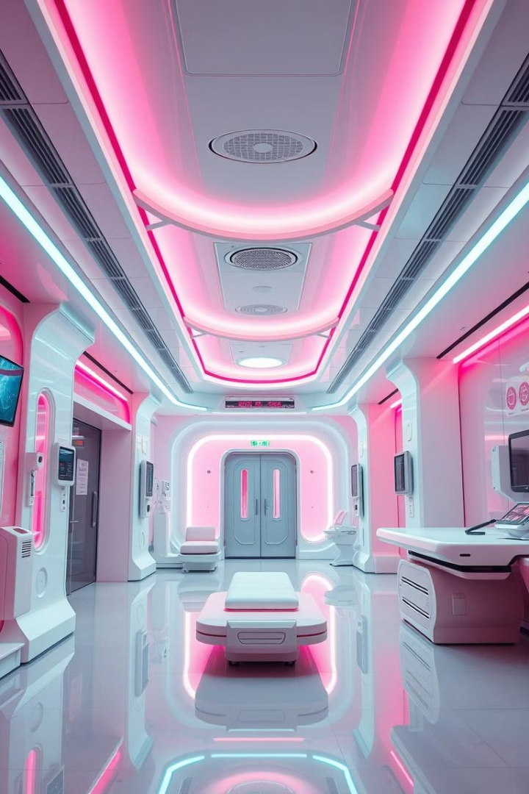




The Future of HMS
Telemedicine Expansion
Remote consultations and monitoring capabilities.
Wearable Integration
Real-time health tracking from patient devices.
AI Analytics
Predictive insights to enhance patient outcomes.
Innovation Commitment
Continuous improvement toward healthcare excellence.

Slide 8
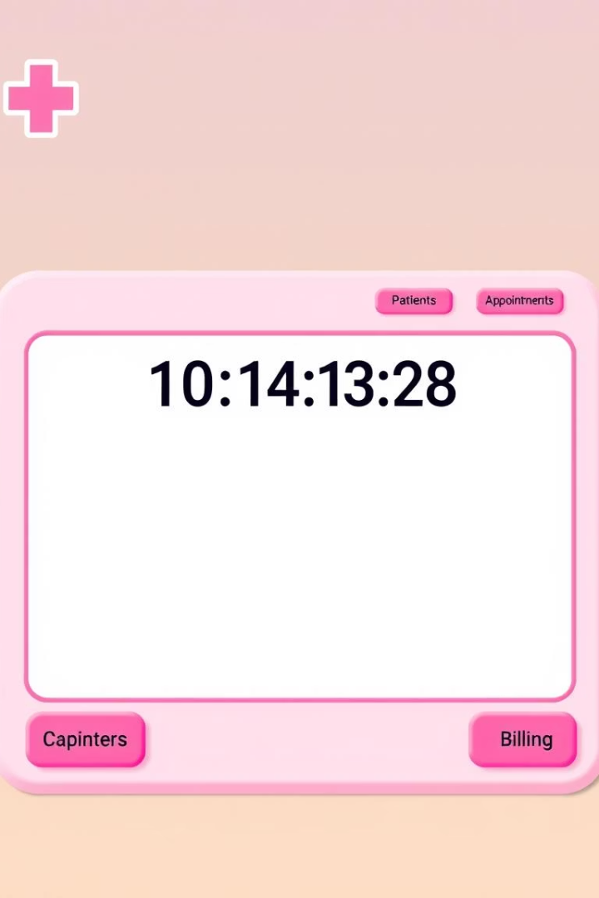
Technical Overview
The system is built using a Graphical User Interface in Java.
This offers a user-friendly and responsive experience for all roles.

